Slide 1
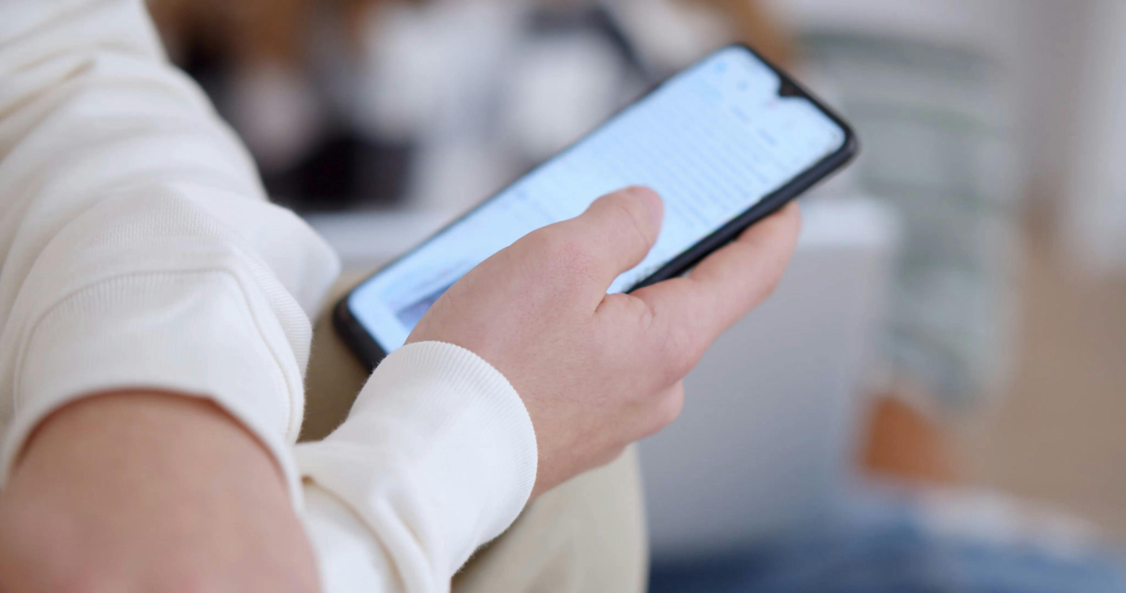
Locked
By The Doomscrollers

Slide 2
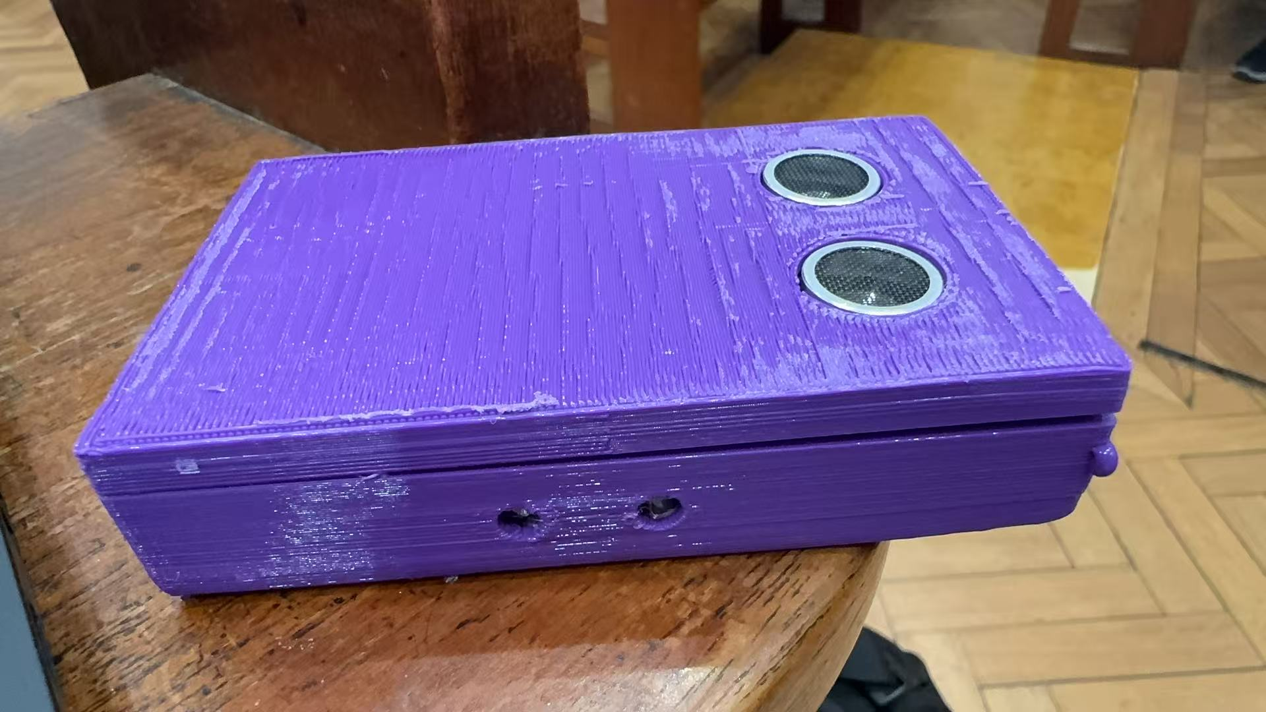

Slide 3

PROBLEM
concentration and focus
stress and mental wellbeing

Slide 4
Solution: Locked
MagSafe
Movements of phone
AI analyse laptop cam.
RESPONSE

Slide 5
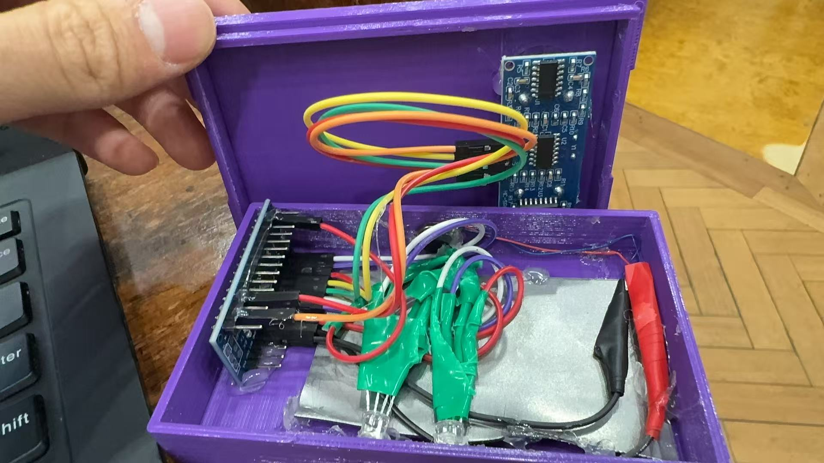
VIBRATION
METAL PLATE
LED

Slide 6

Check phone on Table?
Ultrasonic sensor in the device
INCLINATION on phone streams to MATLAB app
PRESENTS OF PHONE - YOLO one pass neural network
head and eye tracker -MediaPipe (neutral network on certain points on the face)
3 states
Check Study Status

Slide 7

States
Locked-in
Distracted
Distracted > 5min

Slide 8
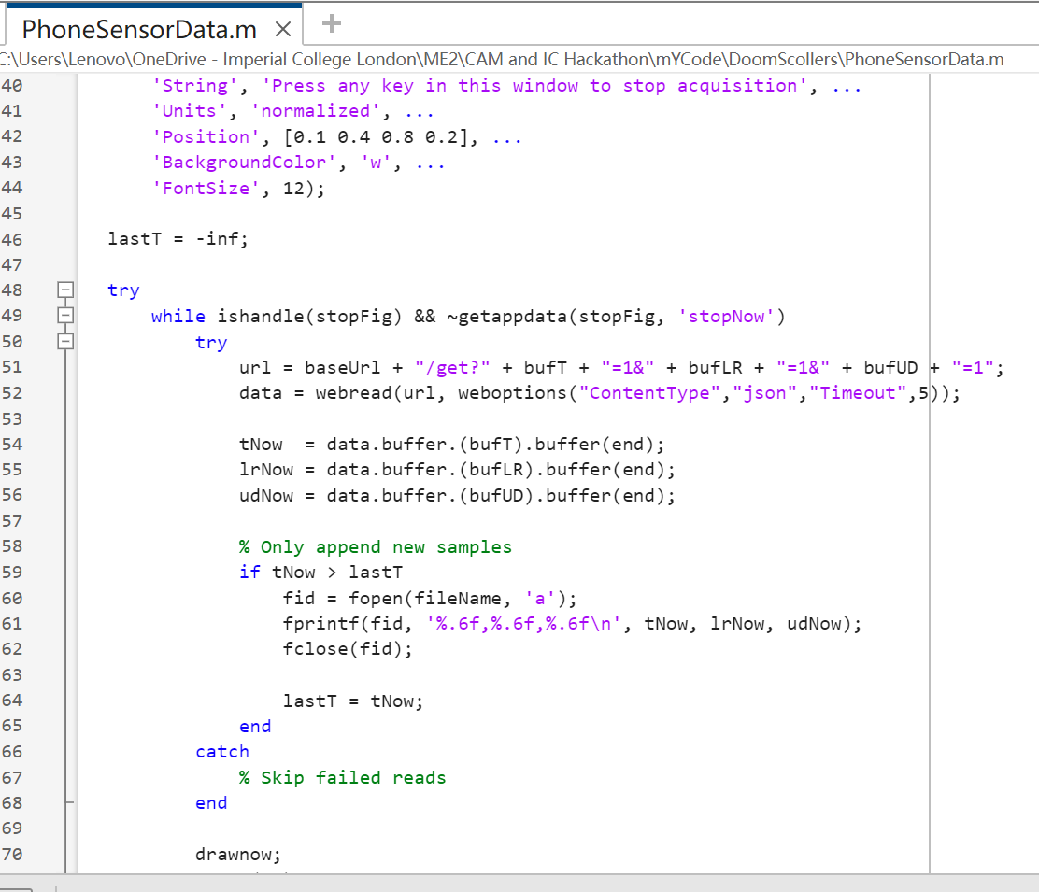
MATLAB
Receive Data of Inclination
->csv.
Matlab GUI…

Slide 9

FUTURE
Wireless charging
Magnets for Magsafe
Better sensor
Offline Streaming
GUI

